Slide 1
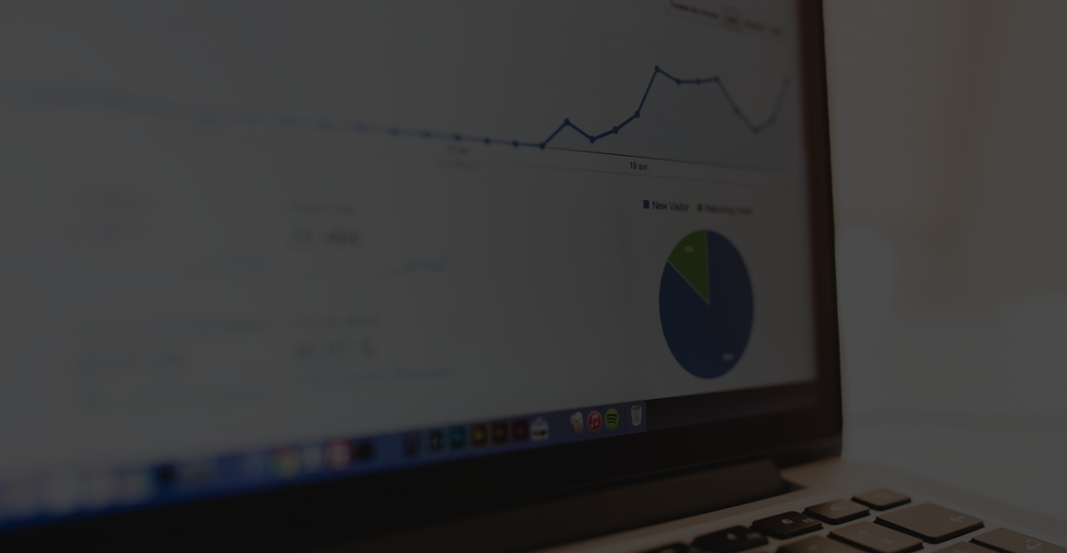

Stock Index Forecaster using ML
GUIDE : Mrs.T.Monika Singh
PROJECT BY :
160619733011- Reshmika Dhannarapu
160619733059- Vyshnavi Yelgoe
160619733044- Sreeja Sogala

Slide 2
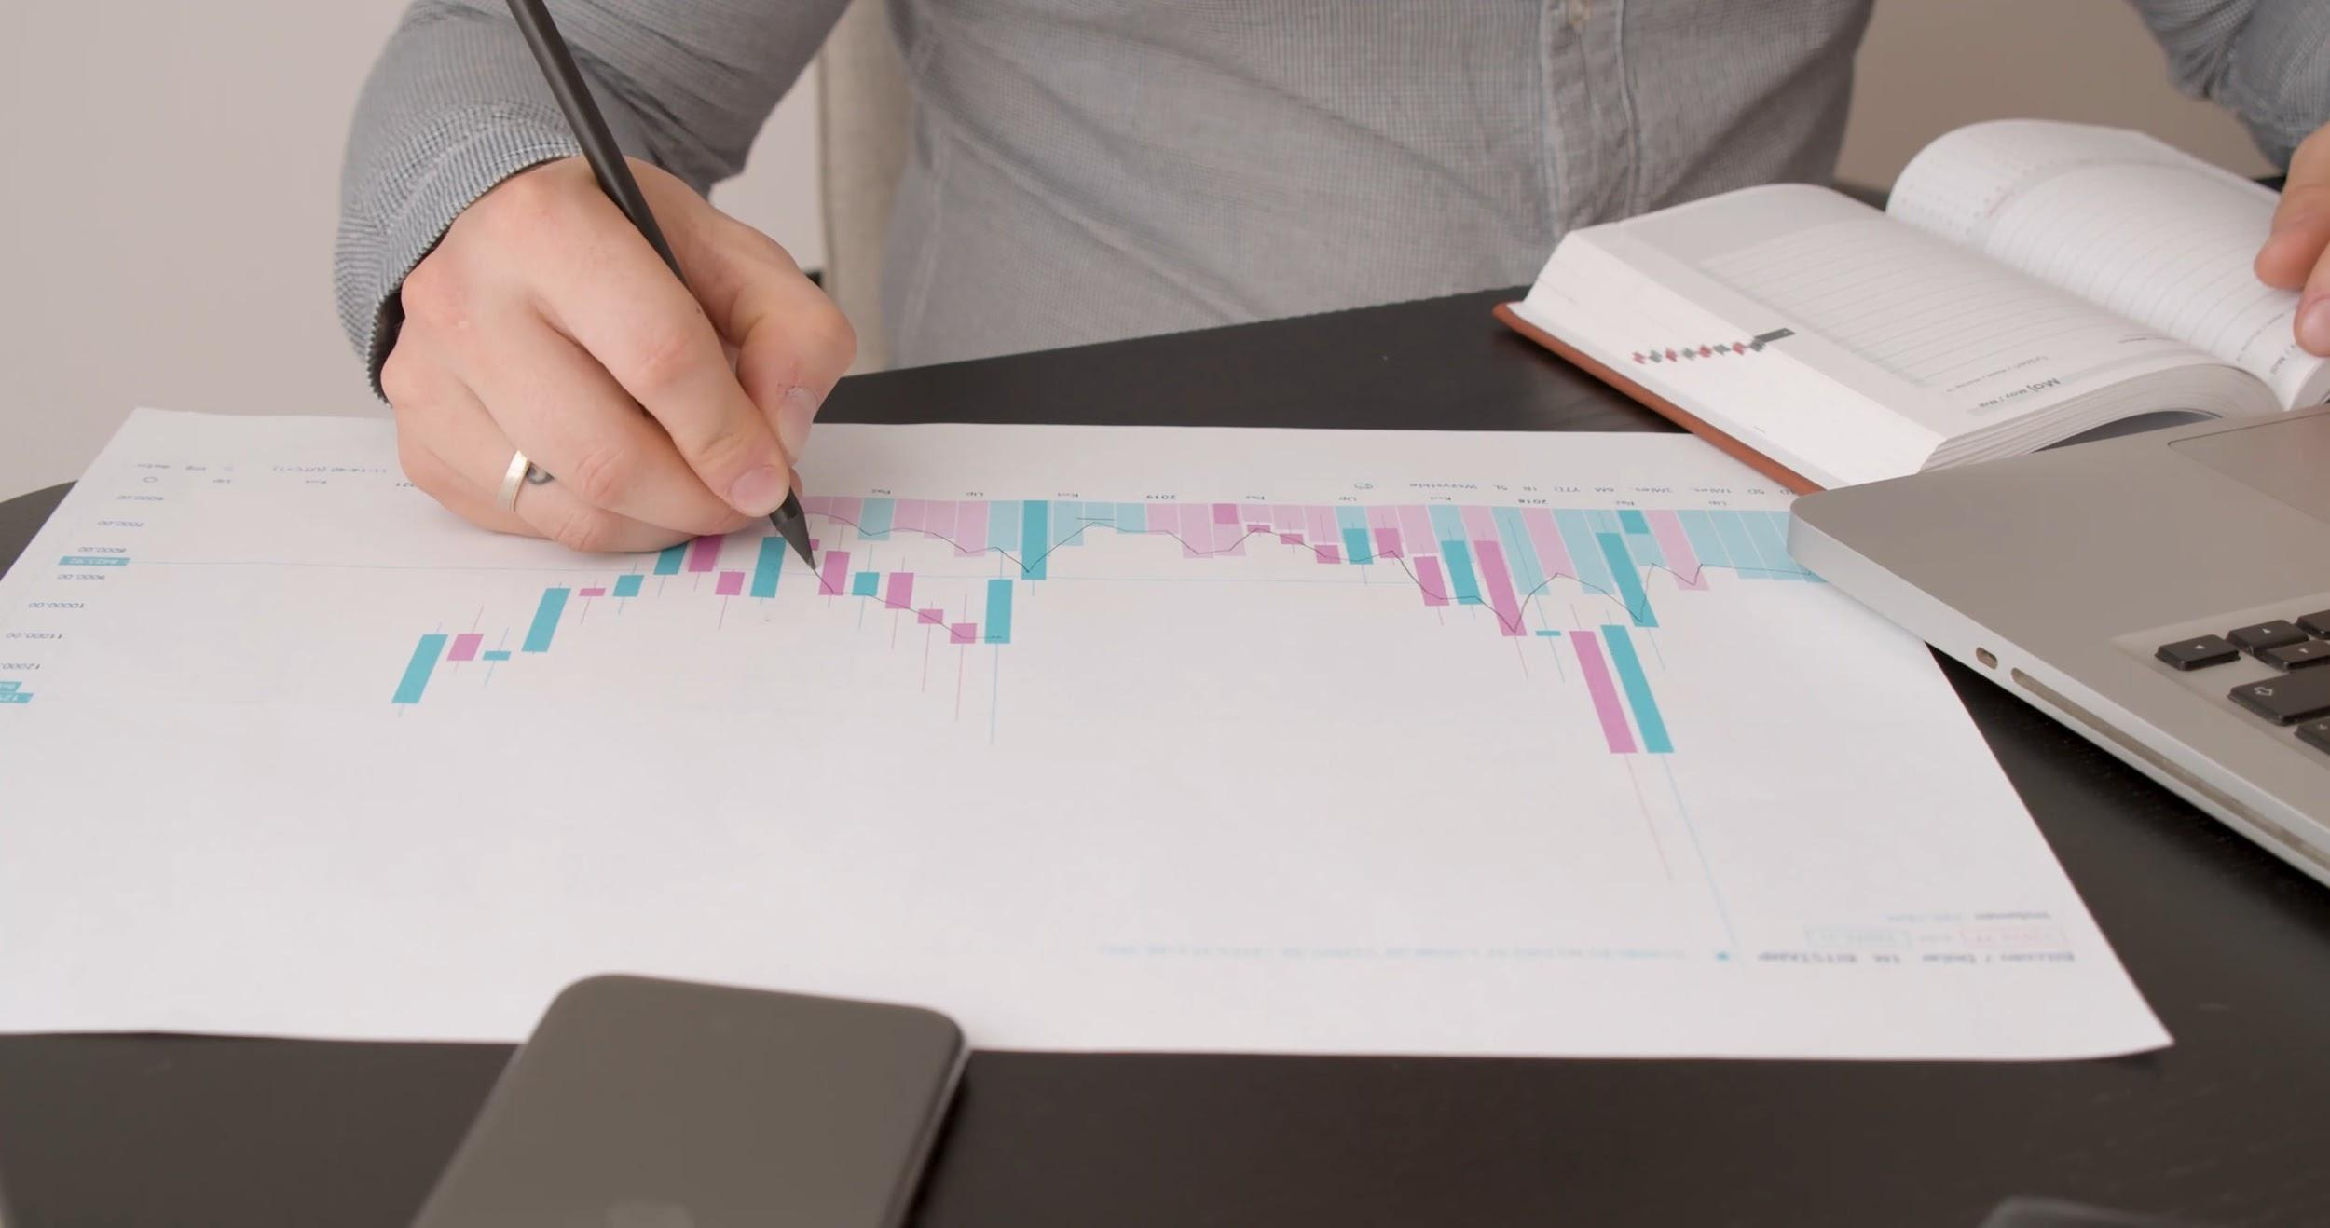

Why manual analysis?
Use Stock Index Forecaster
Start investing on right times and get high returns!

Slide 3
Introduction
The most crucial problem of the investor is to find the right approach in order to attain maximum profit.
One right decision in stock market can create a huge difference on an investor's life.
We built a web app build to visualise the direction of stock prices.
It also predicts values hence makes way for great investments

Slide 4
Proposed Model
Displays Company Description
Displays Price plot from 1995 to present date
Displays separate plotting considering the indicators.
Easy UI
User controlled Information
Beginner Friendly
Prediction of price plot for user prompted no of days.
20XX | 20XX | 20XX | 20XX

Slide 5
Hardware Requirements
Processor: Intel i5 or more
Motherboard: Intel Chipset
RAM: 8GB or more
Hard Disk: 16GB or more
Disk Drive: 1TB
20XX | 20XX | 20XX | 20XX

Slide 6
Software Requirements
Microsoft Visual Studio Code
Python 3.8
Pip Libraries such as Numpy,Dash,yfinance, pandas etc

Slide 7
Objectives
To reach beginners and experts equally
To create a user controlled environment
An assistance tool to help understand stock market
To make investing easy by predictions
Analyse the price plot by indicators
To maximize profits and benefit from information.
To create a good investment decision support system

Slide 8
Steps to build the web application
Create basic website layout
Creating a Machine Learning Model
Generating a company's information and graphs
Binding elements in a Single Server
Styling the application's web page

Slide 9
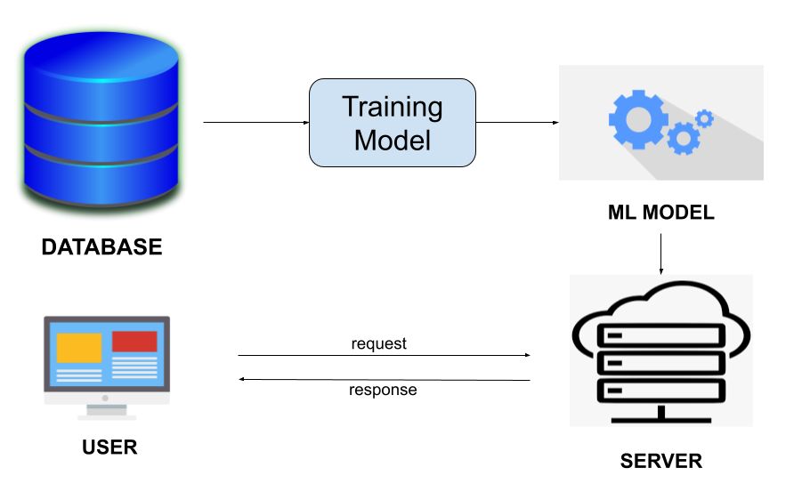
Project flowchart

Slide 10
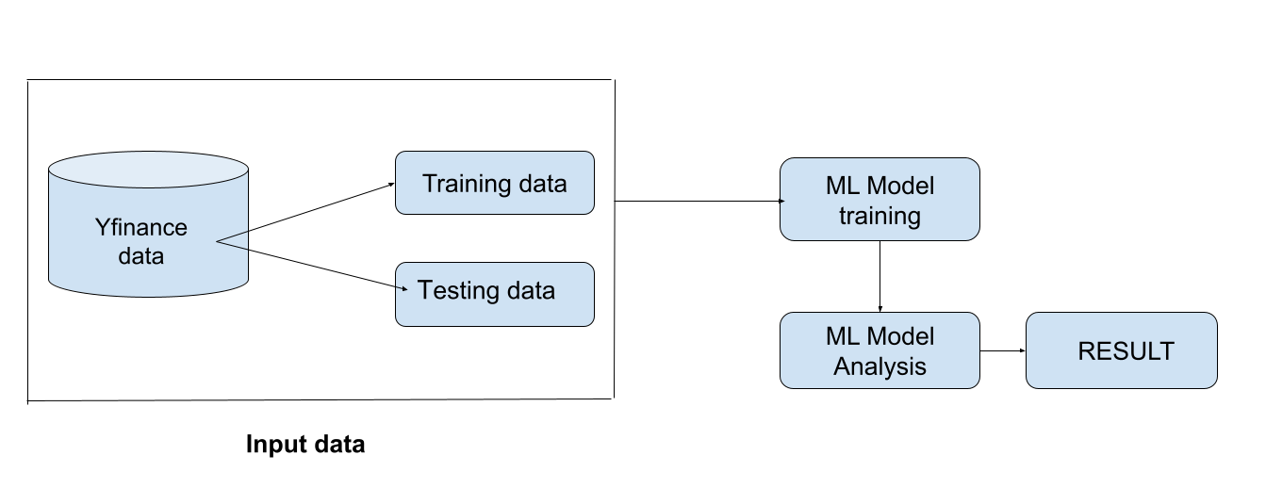
Machine learning flowchart

Slide 11
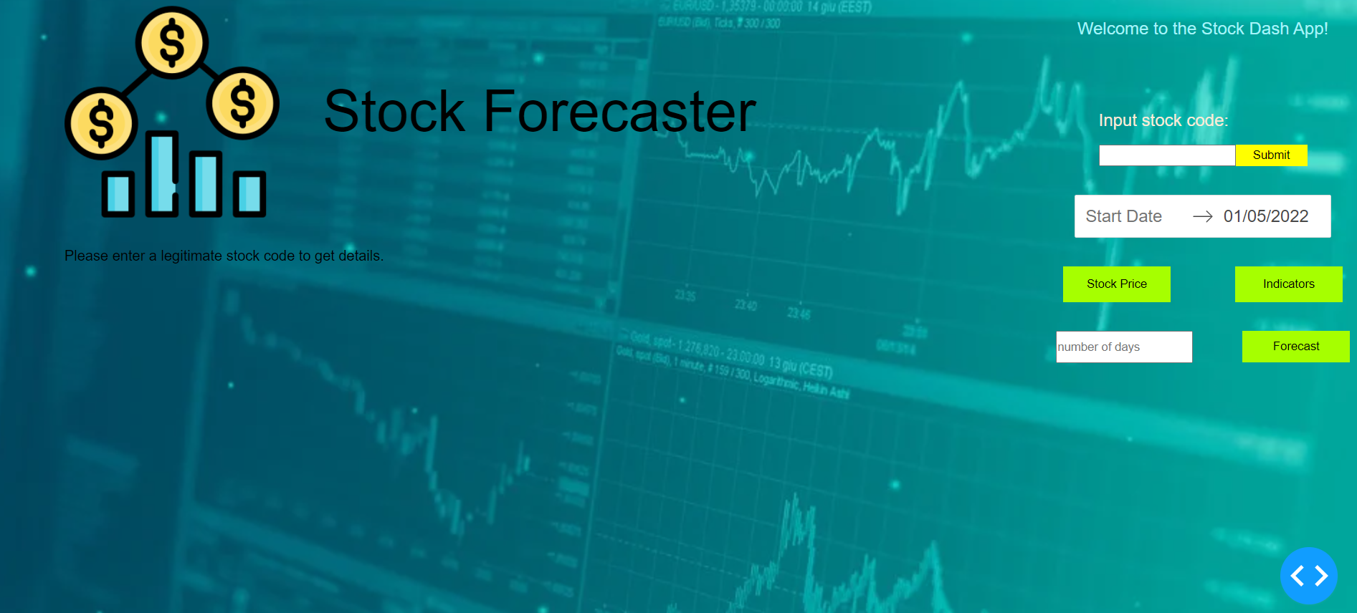
Output Screens

Slide 12
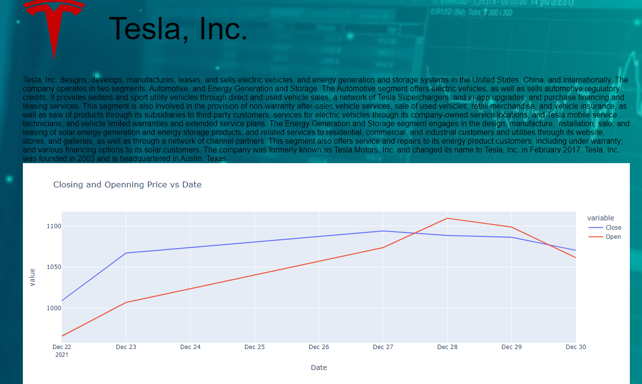
Output Screens

Slide 13
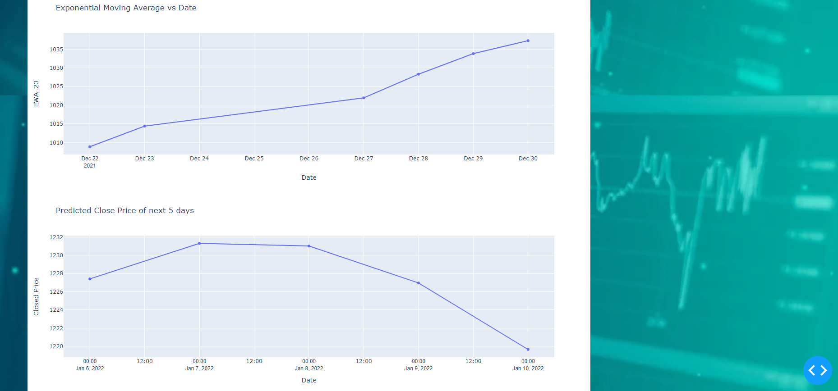
Output Screens

Slide 14
Scope
Wide range of users
Visualised results
Different types of detailed graphs
Easy to use
Accurate Information.

Slide 15

Conclusion
This project successfully helps people to invest right and predict the data as per the user requirements with utmost accuracy using machine learning technologies.

